Slide 1











Pathpulse.ai
THE X - FAIR
HACKATHON
EcoPulse
The IoT System That Reads Nature's Stress
Team The Rebellion | IoT and Embedded Systems
|Team ID: XFAIR0096

Slide 2

The Problem
Current Reality
The Cost
Farmers rely on late visual cues to detect plant stress, resulting in delayed intervention and significant crop losses.
Research demonstrates up to 30% yield loss due to undetected drought stress and other environmental stressors.
The Need
Real-time monitoring enables proactive farming, supporting sustainable agriculture and resource efficiency globally.

Slide 3
The Solution
EcoPulse: An Integrated Sensor System
1
2
Real-Time Sensing
Intelligent Analysis
Multi-parameter sensors capture soil moisture, temperature, light intensity, and plant conductivity simultaneously, feeding live data to the system.
recognise environmental and biological stress patterns, translating complex plant signals into actionable human-readable insights.
3
4
Wireless Communication
Visual Intelligence
wifi and LAN protocols enable seamless data transmission from field sensors to cloud-based platforms and mobile dashboards.
Intuitive app dashboard displays real-time plant health metrics, stress alerts, and predictive recommendations for proactive farm management.

Slide 4

Department of Electrical and Computer Engineering MITWPU
Team The Rebellion || X-Fair 2025
"EcoPulse bridges the gap between nature and technology."
Team The Rebellion believes in using technology to understand—not just automate—the natural world.
Empowers Farmers
Real-time insights enable smarter decisions and resource management.
Reduces Waste
Optimizes water and fertilizer use for sustainability.
Climate Resilience
Contributes to sustainable growth and ecological balance.

Slide 5
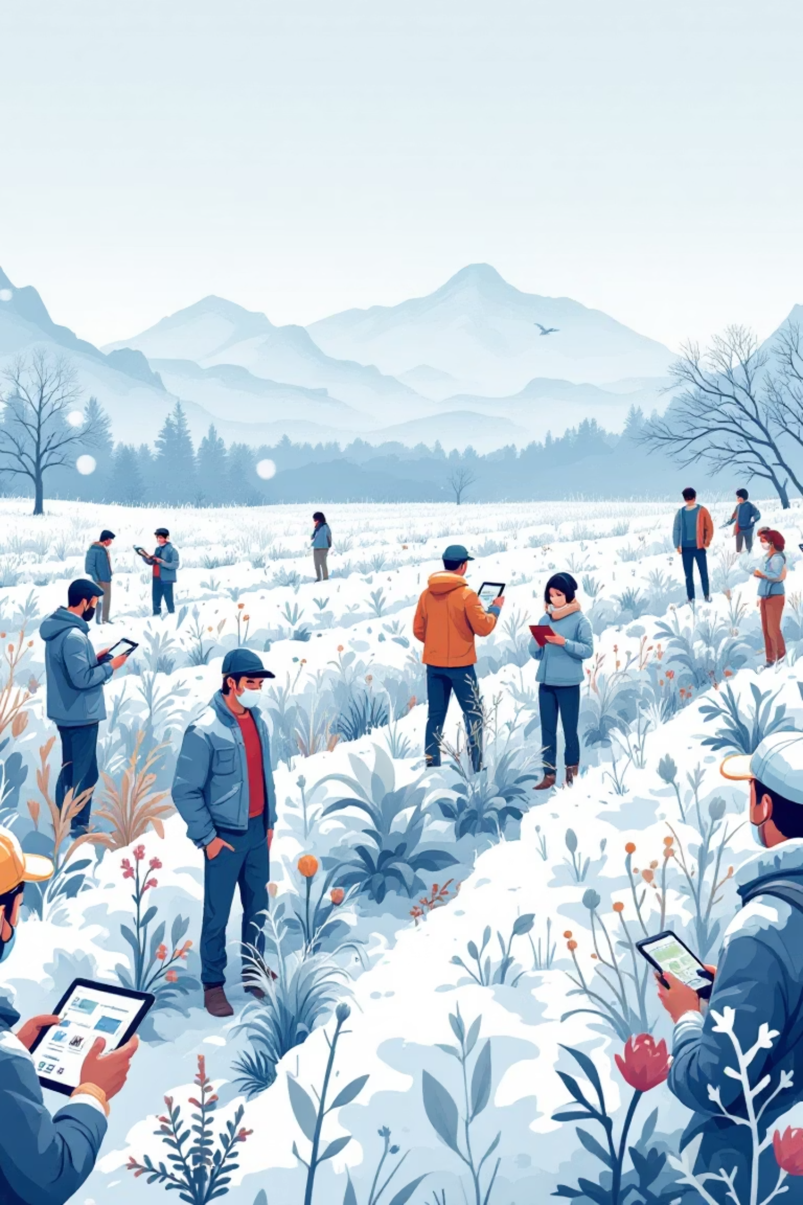
Domain & Users
Technical Domain
Target Stakeholders
Internet of Things (IoT)
Farmers growing sensitive crops
Sustainable Agriculture
Environmental Monitoring
Agricultural researchers
Environmental scientists
Sustainability practitioners

Slide 6




Technical Architecture
Sensor Layer
Multi-parameter sensors capture environmental data
Edge Processing
Raspberrypi microcontroller processes signals in real-time
Communication Hub
wireless protocols transmit data securely
User Interface
Flask-based dashboard delivers actionable insights

Slide 7

Technical Stack & Development
Hardware
Software & Frameworks
Arduino microcontroller
Arduino IDE for embedded code
Raspberry Pi processing unit
Flask web framework
Multi-parameter sensors-
Temperature and humidity sensor,
Moisture sensor, Light sensor
Python 3 and Pyserial
Wireless communication modules

Slide 8










What Makes EcoPulse Unique
IoT
Gives Plants a Voice
Combines IoT with environmental sensing for sustainable agriculture.
Translates biological signals into emotion-like data—world-first concept.
Modular & Scalable
Real-Time Detection
Monitor one plant or an entire greenhouse with the same system.
Identifies stress within minutes, enabling immediate intervention.
Low-Cost
Built with open-source components for accessibility and affordability.

Slide 9








Impact & Value Proposition
Early Detection
Yield Improvement
Identify plant stress 5–7 days before visual symptoms appear, enabling preventative interventions.
Reduce crop losses by up to 30% through proactive management and optimal resource allocation.
Digital Voice
Translate complex plant signals into understandable data, democratising agricultural intelligence for all farmers.
Resource Efficiency
Minimise water waste and fertiliser overuse whilst maximising agricultural sustainability and environmental protection.

Slide 10
Preventing Agricultural Disasters: Real-World Impact
🌾 Punjab Wheat Crisis (2022)
💧 California Almond Drought (2023)
The Crisis: 60% water restrictions forced abandonment of 120,000 acres of almond farms. Traditional irrigation wasted 45% of precious water resources.
The Devastation: Unexpected frost caused 40% crop damage across Punjab, resulting in losses exceeding ₹2,000 crores and devastating thousands of farming families.
EcoPulse Solution: Automated frost protection system activates solar-heated mist sprayers when temperature drops below 4°C, raising ambient temperature by 3-5°C to protect vulnerable crops.
EcoPulse Precision: Crop-specific moisture sensors trigger drip irrigation only when soil moisture falls below optimal thresholds, eliminating waste while maintaining crop health.
Impact: Could have saved 800,000+ tons of wheat
Impact: 45% water savings = millions of gallons daily

Slide 11


Future Vision & Scalability
Phase 1: Cloud Integration
Phase 2: Predictive Intelligence
Centralised cloud dashboard enables remote monitoring across multiple farms and real-time data synchronisation.
Weather forecasting integration and predictive algorithms provide advance warnings and optimal intervention strategies.
Phase 3: Autonomous Networks
Phase 4: Ecosystem Growth
Solar-powered sensor nodes and LoRa mesh networks scale EcoPulse to remote and rural agricultural communities.
Voice notifications, mobile app, greenhouse integration, and API partnerships create a comprehensive smart farming ecosystem.

Slide 12



Intelligent Prediction Through Machine Learning
Random Forest Prediction
Continuous Data Logging
Localized Weather Forecasting
Real-time monitoring of temperature, moisture, and environmental patterns creates comprehensive datasets that improve prediction accuracy over time
AI models analyze continuous environmental data to predict irrigation needs, optimal watering schedules, and upcoming weather conditions with remarkable accuracy
Location-specific environmental modeling enables precise predictions for micro-climate conditions, allowing farmers to prepare for adverse events before they strike
EcoPulse transforms agriculture from reactive crisis management to proactive crop protection—potentially saving ₹15,000+ crores annually in India alone while reducing water consumption by 40-50% through solar-powered, zero-cost operation.

Slide 13

Research Foundation: Our Pillars of Knowledge
Our project stands on the shoulders of giants, integrating insights and tools from a vibrant global research and open-source community. This page acknowledges the foundational work that made EcoPulse possible.
Key Insights: Groundbreaking Research
Data Foundations: Fueling Our Models
IEEE Paper: "AI-Powered IoT Systems for Smart Agriculture" (IEEE Access, 2024)
PlantVillage Dataset – Kaggle
"Environmental Sensor Fusion for Sustainable Farming”
Soil Moisture & Climate Data (NASA POWER)
Technical Toolkit: The Engine of Innovation
Community Contributions: Shared Knowledge
Flask – for live dashboard web interface
Arduino IDE Documentation
PySerial – Arduino–Pi communication
HTML,CSS and Javascript – For website creation and styling
MIT app inventor – For app creation.
Raspberry Pi OS (Raspbian) official guide
We are grateful to the creators of these resources, whose innovation continues to inspire our journey.

Slide 14



A Heartfelt Thank You
We extend our sincere gratitude to everyone who contributed to EcoPulse and this presentation.
Our Audience & Hosts
Mentors & Institution
Community & Future
Thank you for your time, engaging questions, and for the X-Fair platform.
Grateful for the invaluable guidance from our mentors and the university's support.
Thanks to the open source community for foundational tools. We envision EcoPulse's global impact.
Team The Rebellion | XFAIR0096 | X-Fair 2025

